Slide 1
Development Methodology
N. Draper

Slide 2
Introduction
Development Process
Test driven development
Continuous Integration
  Automated build and test
Trac Ticket workflow
SVN commit practices
Code reviews

Slide 3
Development Process
Iterative development
2-4 development week cycles
  Instrument scientist input prioritises tickets
  Developers estimate and select tickets
  Developers complete the code & documentation
  Final automated build Manually tested
  Release

Slide 4
Test Driven Development
For each new method that is testable
  Write the test
  Check the test fails (Optional)
  Write the method specification
  Check the test fails (Optional)
  Write the method body
  Check the test passes

Slide 5
Test Driven Development
What needs testing
  Every public method.
  Always include tests at the lowest possible unit.
What to test
  Normal values
  Boundary Conditions (max and min values)
  Unexpected values (-ve, null etc)
  Special Conditions

Slide 6
Continuous Integration
Automatically builds and tests code on each change.
  Prevents bugs going undetected in the codebase
  Rapidly identifies side effects in distant code
  Automated testing is only as good as the tests themselves
Most tools are aimed at Java or .Net, but some should work for us.
  CruiseControl, LuntBuild

Slide 7
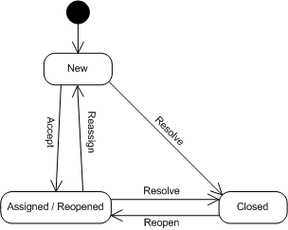
TRAC ticket workflow
 | When | Who
Create | New defining features to be added or defects to be fixed | Primarily PM but can be developers
Accept | When the developer starts actively working on the defect | Developer
Reassign | When further work on the defect needs to be continued by another team member | Developer or PM
Resolve | When the ticket is complete and the code has been checked in. | Developer
Reopen | If later testing discovers that the work is not complete. | Developer or PM

Slide 8
SVN commit practices
Only commit working and tested code.
Commit as frequently as possible
Workflow
  Write tests
  Write code
  Compile all the code
  Run all the tests
  Commit to subversion
  If conflicts are found resolve them and return to 3.

Slide 9
Code Reviews
Public Code Walkthroughs
  Presented in the team meetings every 2-4 weeks.
  Areas of complexity or interest selected.
  Intended to spread knowledge and good practice.

